Slide 1
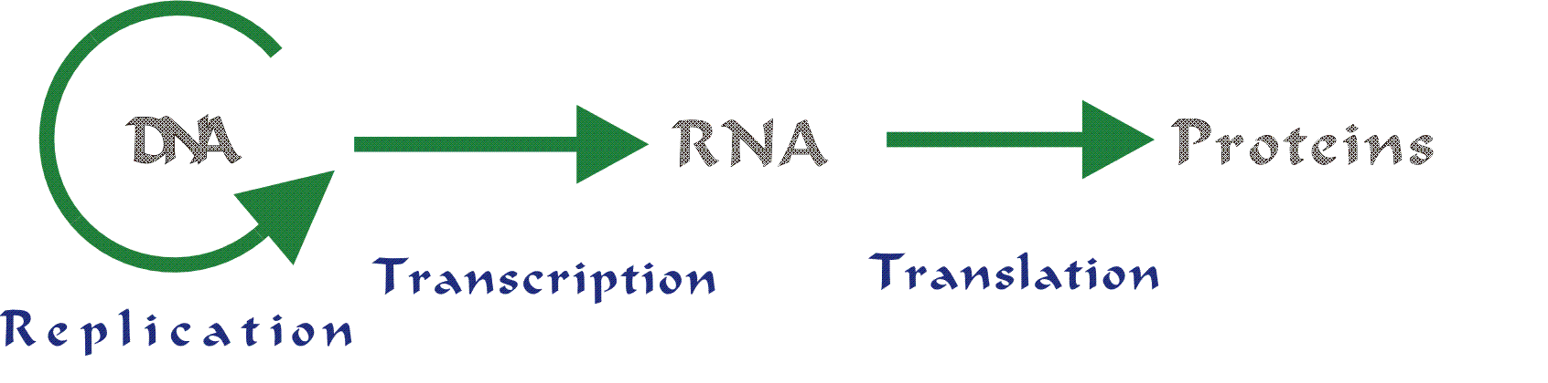

Slide 2
DNA Info
DNA in the nucleus is safe
But DNA in the cytoplasm can be destroyed

Slide 3
RNA – Ribonucleic Acid
Copy of DNA that goes into cytoplasm
  guides synthesis of proteins
 | DNA | RNA
# of strands | 2 Strands | 1 Strand
Type of Sugar | Deoxyribose sugar | Ribose Sugar
Nucleotide Base pairs | A-T C-G | A-U C-G

Slide 4
3 types of RNA
Messenger RNA (mRNA) – complementary to DNA
  C=G, A=U
  Travel from nucleus to ribosome
  Direct synthesis of protein
Ribosomal RNA (rRNA) –forms ribosomes
Transfer RNA (tRNA) – brings amino acids

Slide 5
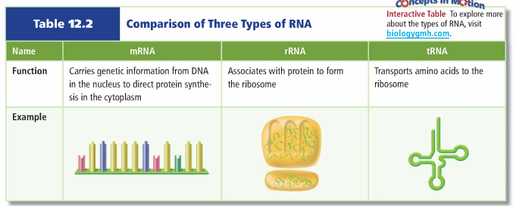

Slide 6
Transcription
RNA is made from 1 strand of DNA
  Specifically mRNA is made
DNA safe in the nucleus
Uses mRNA
To send a message to the cytoplasm

Slide 7
Transcription
Unzip DNA (helicase)
RNA Polymerase binds to synthesize RNA
Match up bases to one strand of DNA
  Uracil instead of thymine
mRNA detaches from the DNA
mRNA moves out of nucleus and into cytoplasm

Slide 8
DNA
mRNA
mRNA
Cytoplasm of cell
Nucleus
Transcription happens in the nucleus. An RNA copy of a gene is made.
Then the mRNA that has been made moves out of the nucleus into the cytoplasm
Once in the cytoplasm, the mRNA is used to make a protein

Slide 9
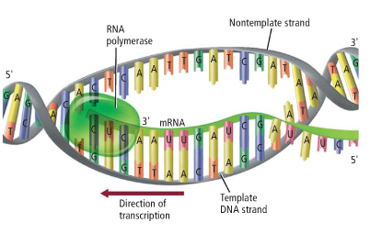

Slide 10
Transcribe DNA
1. If a DNA strand read AAC GTC GCG TAC, what would the mRNA strand be
2. Does the mRNA model more closely resemble the DNA strand from which it was transcribed or the complementary strand that wasn’t used? Explain
3. Explain how the structure of DNA enables the molecule to be easily transcribed. Why is this important for genetic information?
4. Why is RNA important to the cell? How does an mRNA molecule carry information from DNA?

Slide 11
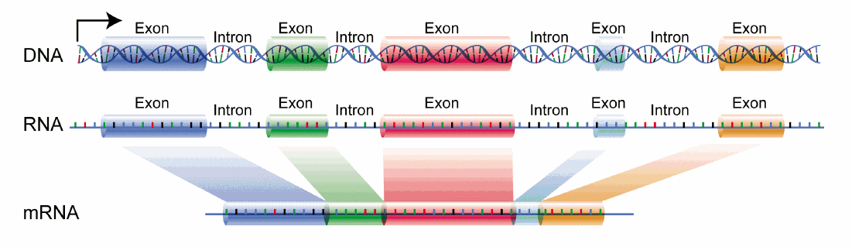
A little more about RNA
DNA is interrupted by short sequences that are not in the final mRNA
  Called introns
  Exons = RNA kept in the final sequence

Slide 12
What are 3 differences between RNA and DNA
Agenda for Today
1. Translation

Slide 13
Translation

Slide 14
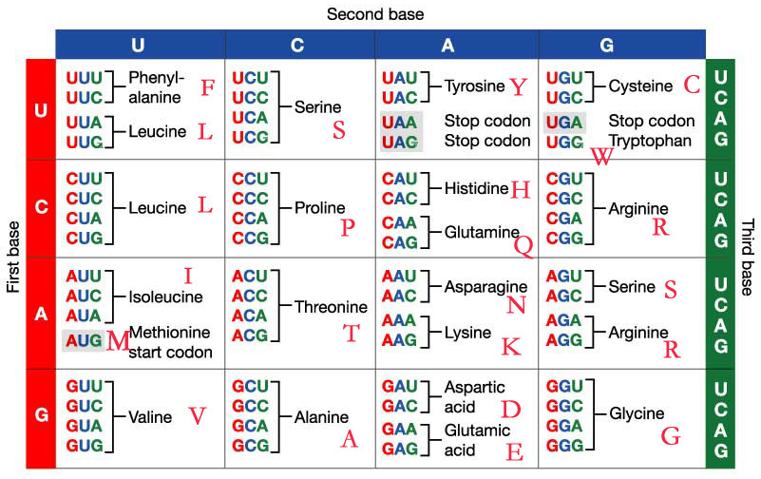
The Code
Every 3 bases codes for amino acid sequence
  Three base code is called a codon
  All but 3 codons code for an amino acid
  AUG = start codon

Slide 16
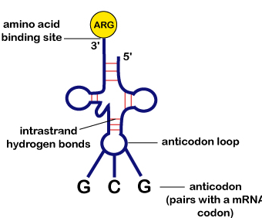
Ribosomes
  2 subunits – only together during translation
  Attaches to mRNA strand
tRNA
3 base sequence at the bottom – anticodon
  Matches the codon on mRNA strand

Slide 17
Translation
mRNA attaches to ribosomes
tRNA moves into ribosome
Anticodon matches with mRNA strand and adds an amino acid
  tRNA leaves ribosome
Stop codon is reached & amino acid chain (polypeptide) detaches from ribosome
  Folds and creates a protein

Slide 19
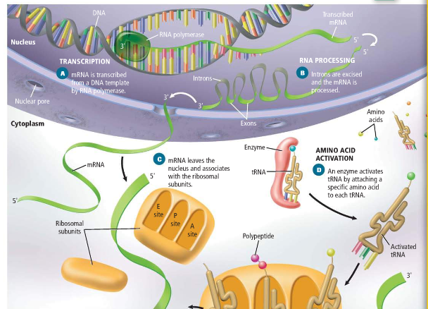
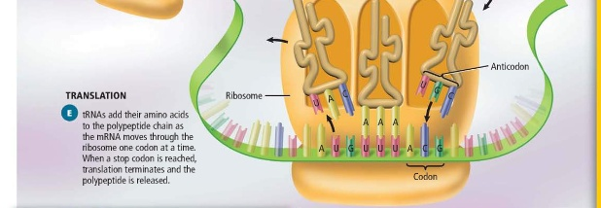

Slide 20
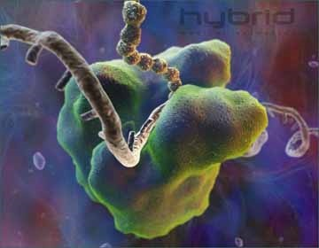

Slide 21
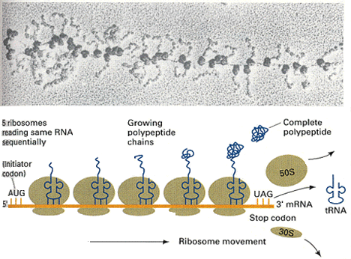

Slide 22
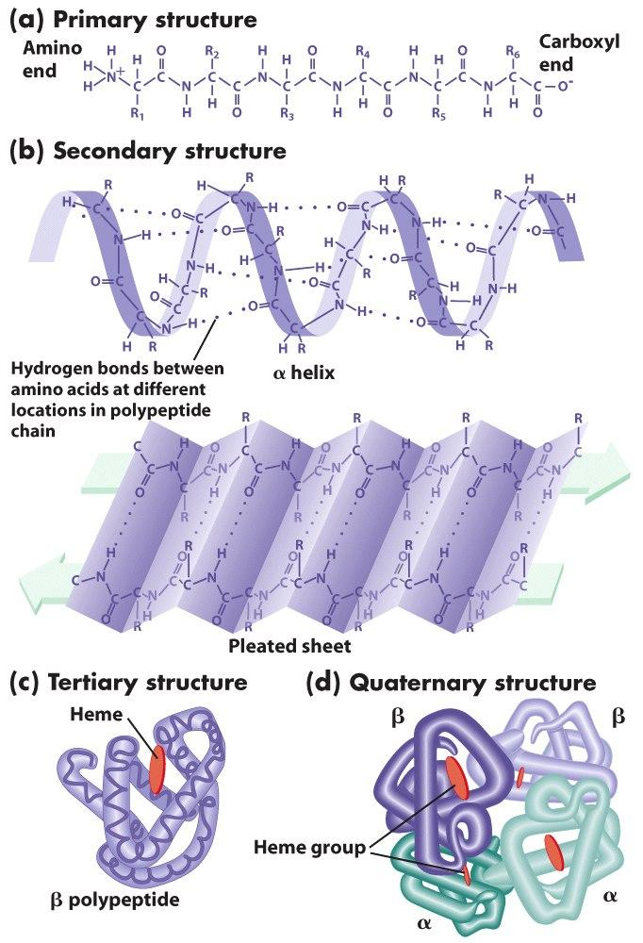
Proteins
Shape depends on interactions among amino acids
  Hydrogen bonding

Slide 23
Translate your mRNA
Write your Amino Acid Sequence
Would you make a complete protein? Explain.
Transcribe and translate the following DNA sequence. Draw a line separating each codon:
A T C G T C C A A

Slide 24
Transcribe (make RNA) and translate (find amino acids) from this strand of DNA
AAA TGC ACG TCG

Slide 25
Whiteboard questions
What does DNA polymerase do?
What does Helicase do?
What does ligase do?
Match the bases below.
5’ – A T C G T A – 3’
List 3 differences between RNA/DNA.
What are the 3 types of RNA?
Where does RNA go after it is made?
Transcribe the DNA below.
A T C G T A

Slide 26
Whiteboard questions
What does RNA attach to when it leaves the nucleus?
Amino Acids are the building block of ________.
What type of RNA brings an amino acid?
When does translation stop?
Where is the codon located? Anticodon?
What is a codon?
Translate the mRNA strand below.
A G C G A G

Slide 27
Replication
DNA Helicase unzips DNA
  Proteins keep it apart
RNA Primase adds starter segments
DNA Polymerase adds nucleotides to DNA
  Leading – continuous adding of bases
  Lagging – Okazaki fragments
DNA Ligase fills in gaps

Slide 28
Transcription
DNA Helicase unzips DNA
RNA Polymerase adds bases
  Only 1 strand of DNA gets copied
RNA detaches from DNA strand and moves into cytoplasm

Slide 29
Translation
mRNA attaches to ribosomes
tRNA moves into ribosome
Anticodon on tRNA matches with codon on mRNA strand
  Amino acid is added
Stop codon is reached & amino acid chain (polypeptide) detaches from ribosome
  Folds and creates a protein

Slide 30
DNA vs. RNA
DNA | RNA
2 Strands | 1 Strand
Deoxyribose sugar | Ribose Sugar
A-T C-G | A-U C-G

Slide 31
Mutations
Mutations: Changes that occur to the chromosomes.
-These can be both good or bad.
-Most Mutations are never shown.
-These can occur in any cell that divides.
-Mutations can eventually lead to changes in the entire population over many years.

Slide 32
Gene Mutations
These mutations involve individual genes.
-Any chemical change that affects the DNA can cause this type of mutation to happen.
-Some may cause a change to 1 nucleotide, while some may change many.

Slide 33
Germ Mutations: Mutations that affect the reproductive cells.
Somatic Mutations: These do not affect the reproductive cells.
-They are not inherited.
(Both can occur at the level of Chromosomal and Gene Mutations)
Sex Linked Genes:

Slide 34
Chromosomal Mutations
Change in the number or structure of chromosomes.
-These are mutations that can involve the entire chromosome, on part or even pairs of chromosomes.

Slide 35
Four types of Chromosomal Mutations:
1. Deletion: A loss of part of the chromosome.
2. Duplication: Segment of chromosome is repeated.
3. Inversion: Part of the chromosome is orientated in reverse of its usual direction.
4.Translocation: One part of the chromosome breaks off and attaches to another chromosome

